Slide 1

M. Tech-VLSI and Embedded (E&C) Project Presentation on “IMPLEMENTATION OF MOVING OBJECT DETECTION USING DEEP LEARNING PROCESSING ON RECONFIGURABLE EMBEDDED SYSTEM-ON-CHIP PLATFORMS”
Presented By: Urjit Modhia & Monal Patel , Electronics and Communication, PIT (Parul University)
 | Supervised by: Mr. Carlos Valderrama (External Guide) Head of Microelectronics Department, University of Mons, Belgium
Notes:
semi1009

Slide 2
Outline
Introduction
Methodologies
Neural Networks
Hardware
Jupyter
Programming language
Overlay
Tools
Conclusion
Reference

Slide 3
Introduction
Aim:-
The main aim is to create a platform including neural network functionality used for detection various objects, pedestrian, cars, License plates.
Motivation:- A system used for detection in real time environment.
Why?
Surveillance
Accidental Scenario
Information

Slide 4
Methodologies
Methodologies explored and used:
Neural Network:
BNN (Binarized Neural Network)
YOLO
Library:
OpenCV
Tensorflow
Dataset
Programming Language
Hardware:
PYNQ FPGA
IP Blocks
Overlay
Platform

Slide 5

Neural Network
A neural Network is a computer system modelled on the human brain and nervous system.
A neural network is a series of algorithms that is used to recognize the relation in a set of data through a process that mimics the way the human brain operates. Neural networks can adapt to changing input so the network generates the best possible result without needing to redesign the output criteria.
Binary Neural Network.
YOLO

Slide 6
Neural Network
Binary Neural Network:
Deep Learning Neural Network
Low bit weights and activations are an effective way of fulfilling the increasing requirement for both memory and compute power of Deep Neural Networks.
Loss Factor
Adam optimizer
Gradient Descent
Advantage:
Time for Detection
Accuracy
Hardware Compilation
Memory and Power Consumption
Disadvantage:
Training
datasets

Slide 7
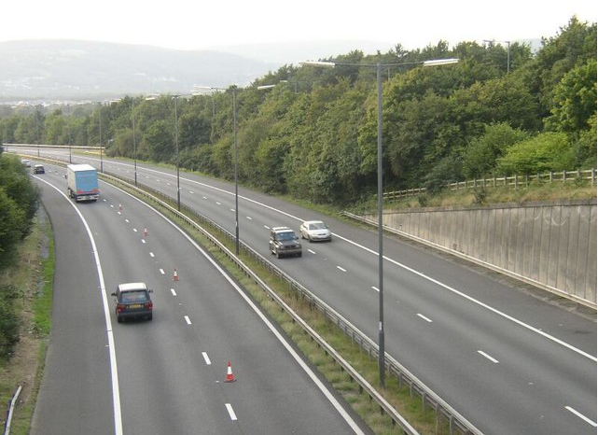
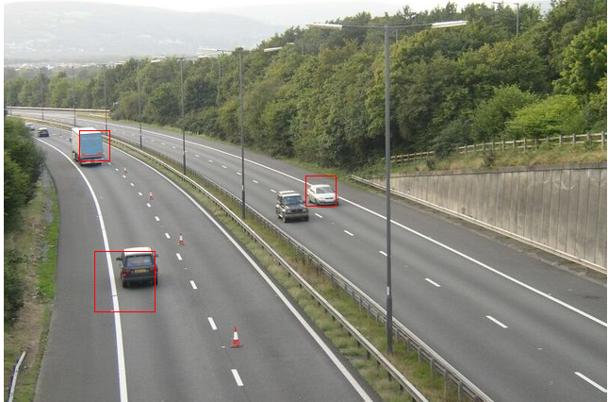
Output
(a) (b)

Slide 8
Neural Network
Yolo:
You Look Only Once
Uses Darknet and Darkflow
Developed as Single Convolutional Layer.
Small Architecture.
Learns Generalizable Representations.
Reason globally entire Image.
Easy and Fast
Dataset used: Coco (80 classes)

Slide 9
Library
OpenCV:
Open Source Computer Vision Library.
More than 2500 optimized algorithms
Available for academic and business purpose for free.
C++, Python, Java and MATLAB interfaces supporting Windows, Linux, Android and Mac OS.
Advantage:
Datasets (Haar-cascade, LBVP-cascade)
Training
Hardware compilation
Disadvantage:
Time
slow

Slide 10
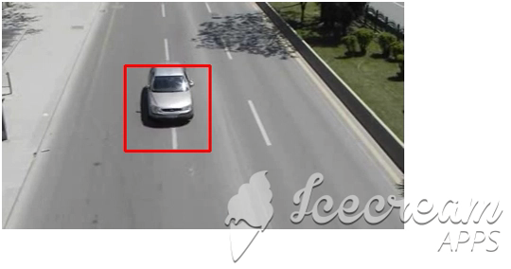
Output

Slide 11
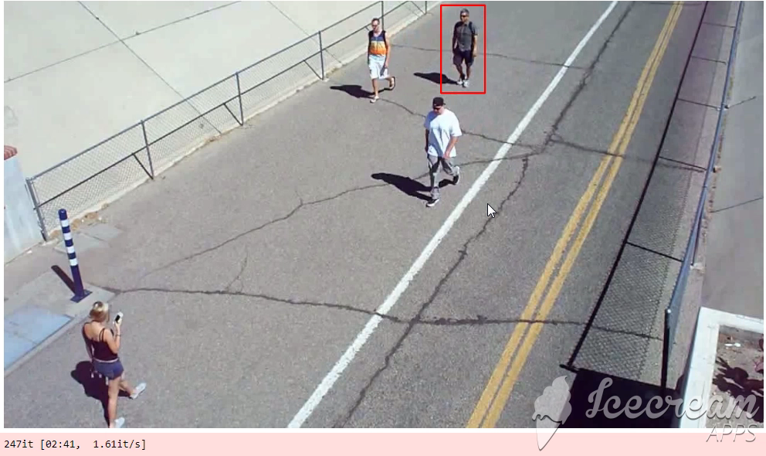
OpenCV result

Slide 12
Neural Network
TensorFlow:
TensorFlow is a Python-friendly open source library for numerical computation that makes machine learning faster and easier
Created by the Google Brain team,
uses Python to provide a convenient front-end API for building applications with the framework.
ease the process of acquiring data, training models, serving predictions, and refining future results.
Advantage:
Libraries
Datasets
Training
Time
Disadvantage:
Hardware Compilation

Slide 13
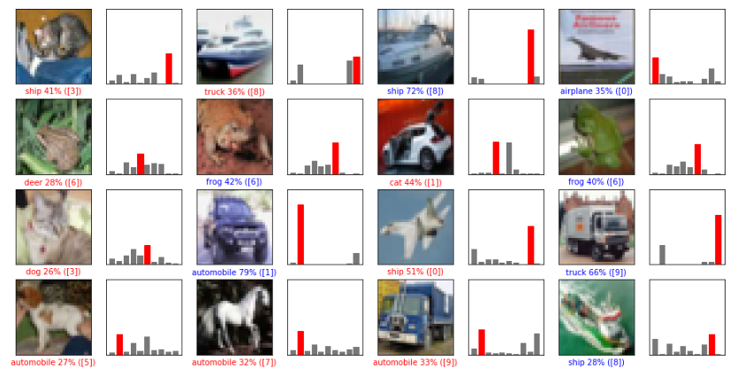
Output

Slide 14
Dataset:
Train Data
Test Data
Annotate Data
Available Cifar-10/100, Mnist, Streetview, ALPR. Cityscape etc.
Custom dataset:
For License plate detection (Indian License plate)
For Face detection
For vehicle detection
Tools Used:
Google scrape (Google Chrome) (raw data “.url”)
Jupyter (downloading data “.jpg”)
Supervisely (annotation and packaging “.json”)

Slide 15
Hardware
PYNQ Board:-
Python Productivity for ZYNQ (Python + Zynq)
Zynq = PS( Processing System) + PL (Programmable Logic)
Introduced by Xilinx.
Open-source.
Language: Python
Environment: Jupyter
PYNQ Image is bootable Linux image including Python and other packages
Why ?
Fast
Using Python language and libraries, designers can explore the benefits of programmable logic and microprocessors in Zynq to build more capable and exciting embedded systems.
high frame-rate video processing
real-time signal processing
low latency control

Slide 16
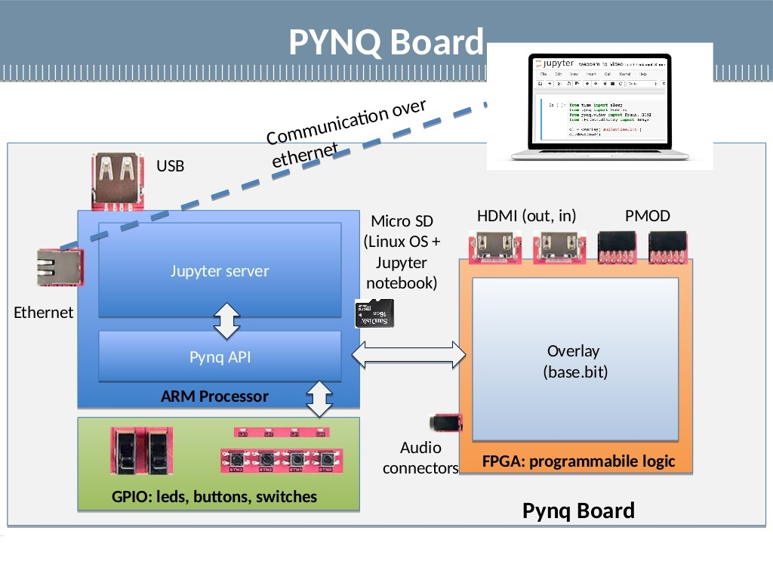
Hardware

Slide 17

Jupyter
Jupyter is an open source project born out of IPython project in 2014.
Interactive computing environment.
Includes live code, equations, explanatory text, plots, images and video
PYNQ can be easily programmed by using Jupyter Notebook with Python Language.
Available for free to use

Slide 18
Programming Language
Python
High level
Interpreted
Dynamic typing
Object-oriented
Useful for fast prototyping of applications with readable codes.
Available Libraries (import os)

Slide 19
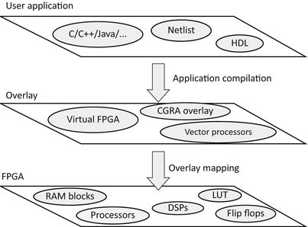
Overlay
Overlays are hardware libraries that extends the Processing System with a programmable Logic Design.
It is a virtual layer of architecture that conceptually locates between the user application and the underlying physical FPGA.
With this additional layer, user applications will no longer be implemented onto the physical FPGA directly.
Instead, the application will be targeted toward the overlay architecture regardless of what the physical FPGA may be.

Slide 20
Tools Block Diagram
Vivado Design Suite (.BIT & .TCL)
SDK (.boot, .fsbl) (Plateform)
SDSoC (Implement Platform)
Vivado HLS (IPs)

Slide 21
Tools
4 tools used:-
Vivado HLS
Insertion of Pipeline and Pragmas in an IP
Output: IP (Intellectual Property)
Vivado Design Suite
IP insertion
Designing Block Diagram of overlay
Output : .Bit, .sdk, .hdf, .tcl
SDK
Imports .hdf file
Creates Plateform which is to be used in SDSoC.
Output : .fsbl, .boot
SDSoC
Custom Plateform insertion.
Creation of Vivado Project.

Slide 22
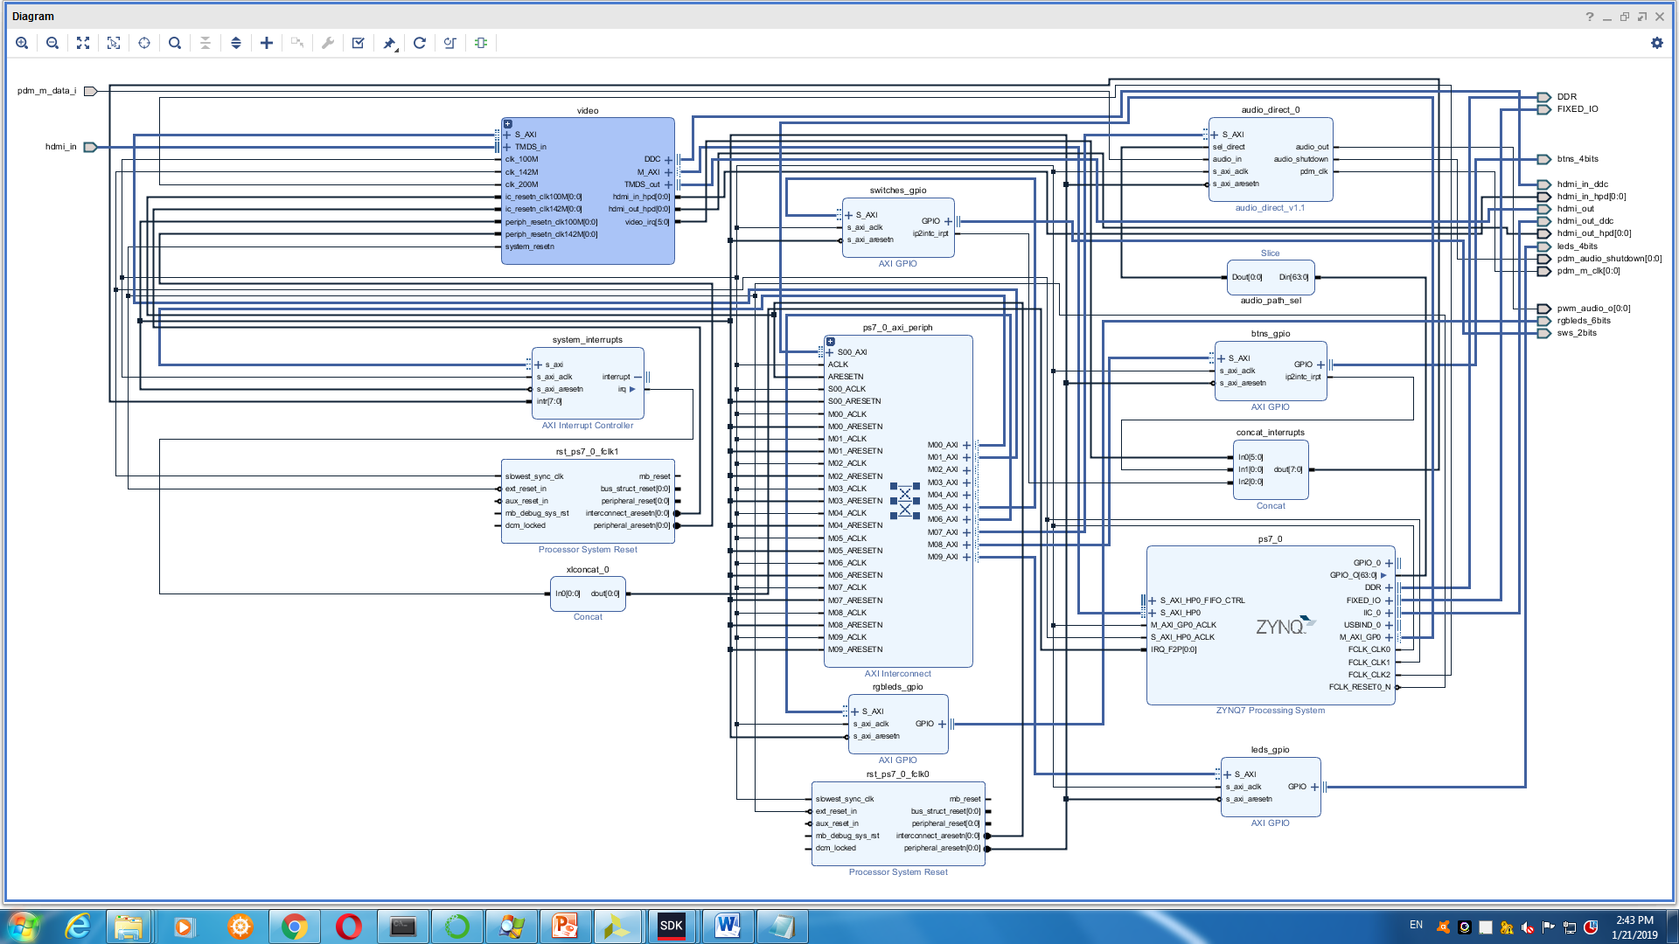
HDMI Overlay:

Slide 23
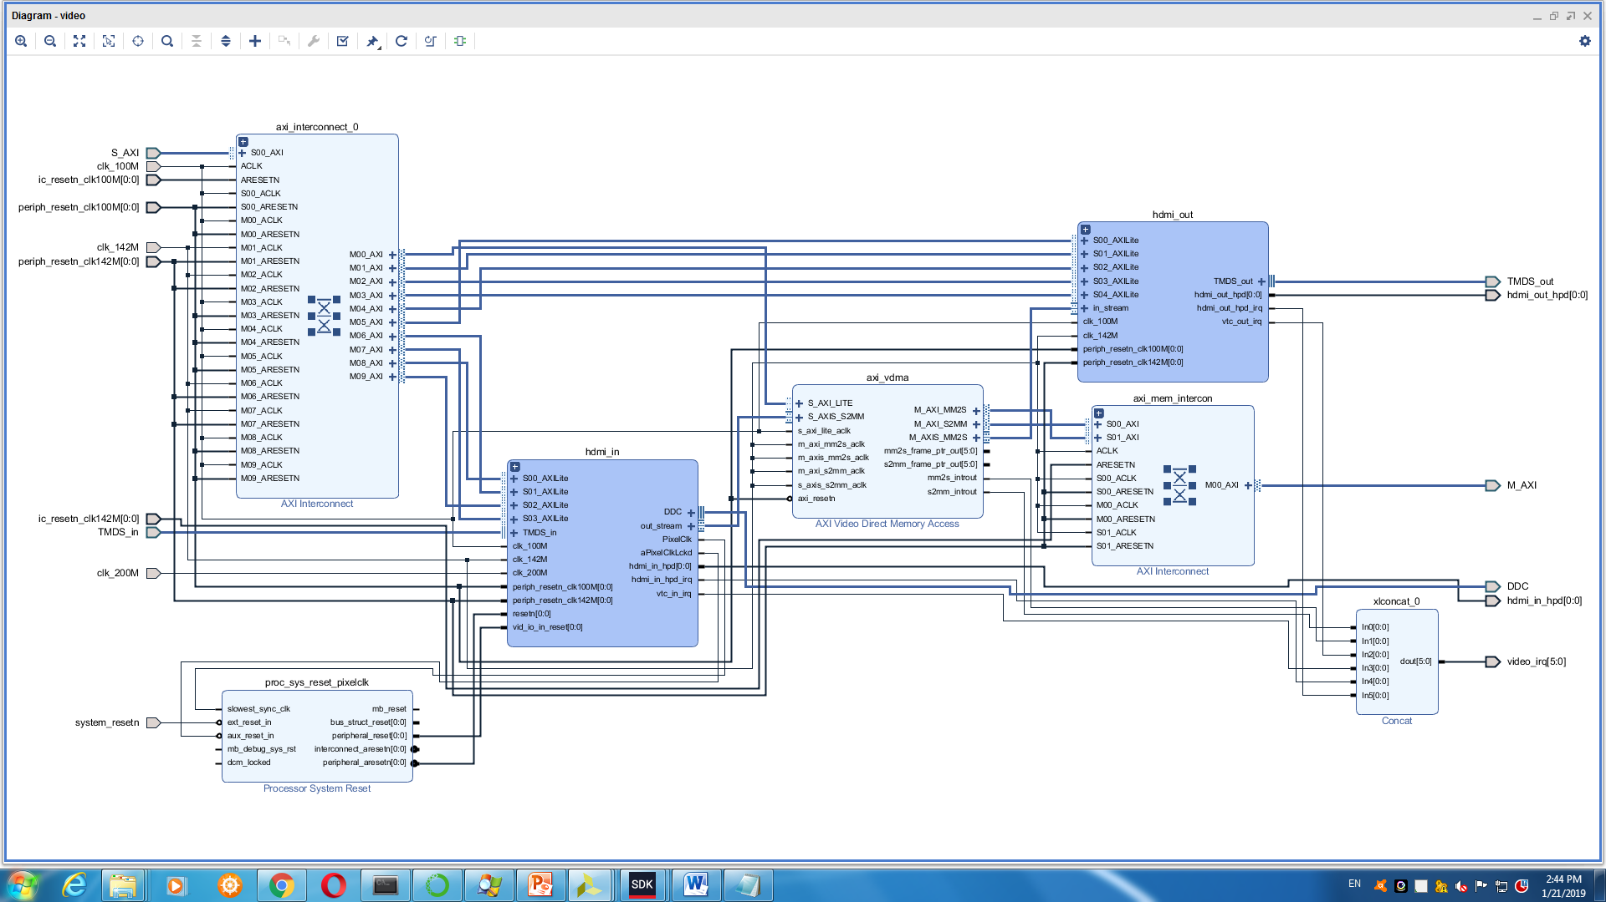
Video IP (HDMI Overlay):

Slide 24
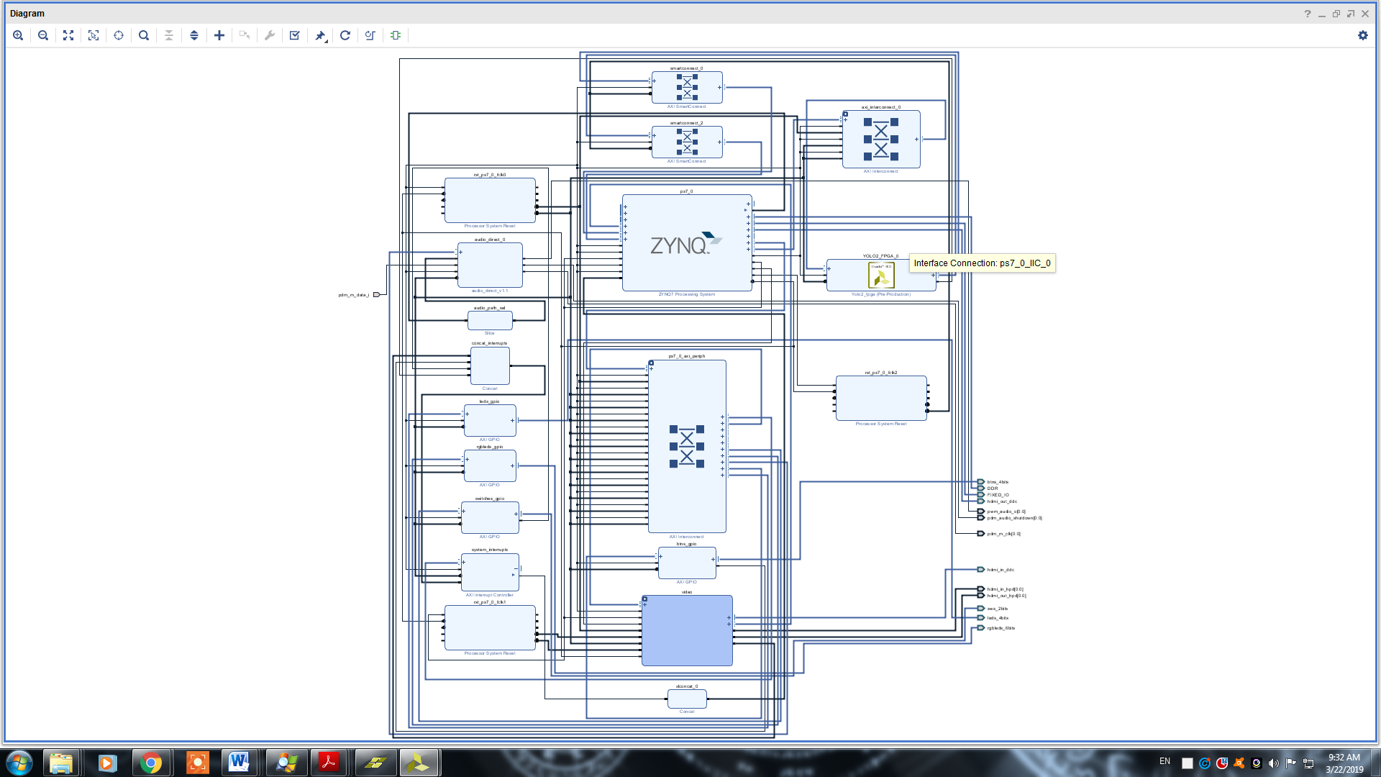
pynqHDMI with YOLO Overlay:

Slide 25
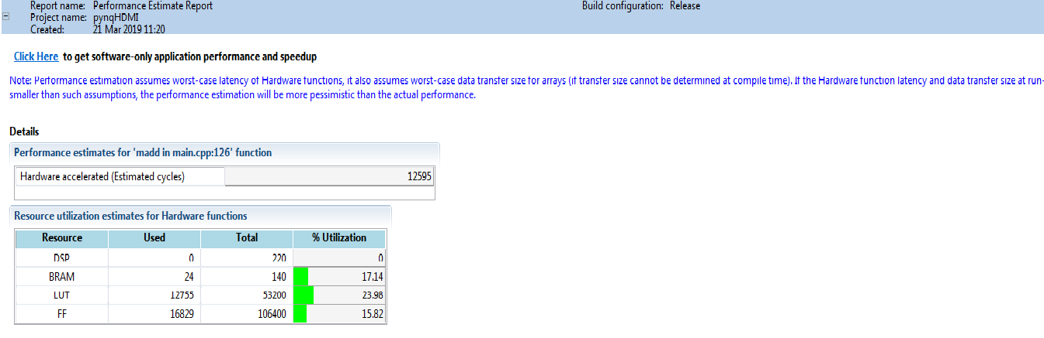
Output
pynqHDMI platform Result:

Slide 26
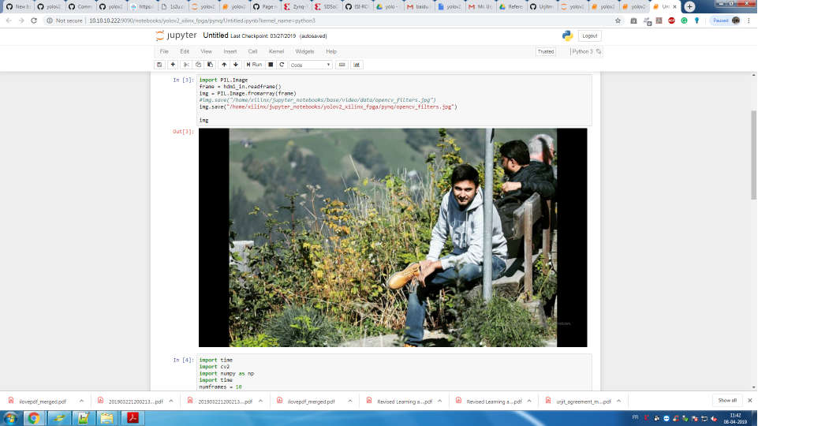
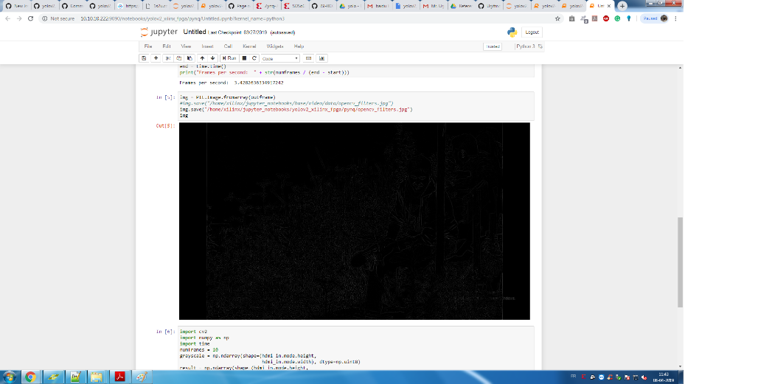
Output
HDMI Overlay Result:

Slide 27

Output
Overlay Result:

Slide 28
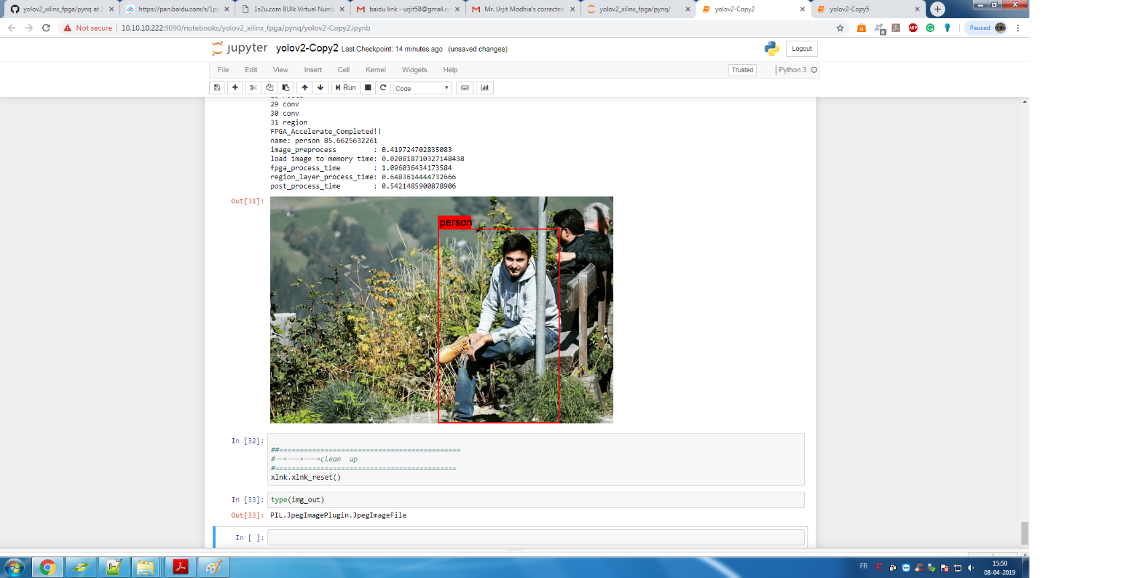
Output
Overlay Result:

Slide 29
Conclusion
Created Hardware Overlay
Studied various Neural Networks
Dataset
Created Hardware platform

Slide 30
Reference
Author | Citation | IEEE Paper/ Journal | Year of Publish | Key Learning
Matthieu Courbariaux, Itay Hubara, Daniel Soudry, Ran El-Yaniv, Yoshua Bengio | Binarized Neural Networks: Training Deep Neural Networks with Weights and Activations Constrained to +1 or -1 | 30th International Conference on Neural Information Processing Systems | 2016 | How to Train BNN Parameters for training
So, Hayden & Liu, Cheng., | FPGA overlays | FPGAs for software programmers | June- 2016 | How to create an Overlay Methods Steps tools

Slide 31
Reference
Author | Citation | IEEE Paper/ Journal | Year of Publish | Key Learning
L. Yuan, Z. Qu, Y. Zhao, H. Zhang and Q. Nian | A convolutional neural network based on TensorFlow for face recognition | IEEE 2nd Advanced Information Technology, Electronic and Automation Control Conference (IAEAC) | 2017 | How to use Tensorflow for detection purpose
R. Dobai and L. Sekanina | Towards evolvable systems based on the Xilinx Zynq platform | IEEE International Conference on Evolvable Systems (ICES), Singapore | 2013 | How to implement evolvable systems on a developed AI board

Slide 32
Reference
Author | Citation | IEEE Paper/ Journal | Year of Publish | Key Learning
B. Janben, P. Zimprich and M. Hübner | A dynamic partial reconfigurable overlay concept for PYNQ | 27th International Conference on Field Programmable Logic and Applications (FPL), Ghent | 2017 | How to use partial reconfigurable bitstreams on PYNQ

Slide 33
Github Reference
https://github.com/ISI-RCG/spicy
https://github.com/dhm2013724/yolov2_xilinx_fpga

Slide 34
Questions?

Slide 35
Thank You

